Slide 1
Project Charter Template
Date

Slide 2
Project Description & Scope
Project Description
- Our team is tasked with assisting Florida in the reopening and recovery process from the COVID-19 pandemic. We will develop metrics and graphics for risk-assessment and safety guidance.
Scope
- Deliverable #1—A Touch Screen or Point and Click Fishbone GUI for Local Residents To Predict Personal Risk and Guide Appropriate Mitigations
- Deliverable #2—Tripwire Metric: Weekly Regional Mortality Actual Versus Normal
- Deliverable #3—Tripwire Metric: Forecast of Local Hospital Max Capacity
- Deliverable #4—Community Vulnerability Map in Tableau or Power BI

Slide 3
Sponsors, Stakeholders and Roles & Responsibilities
Sponsors
The sponsors of this project include the Executive Board of the Florida Department of Public Health and the Governor of Florida. These teams are responsible for providing additional project guidance as well as any necessary signatures for approval.
Stakeholders
The key internal stakeholders of this project would be the State of Florida Departments who receive guidance based upon the analysis. In addition, external stakeholders would include the residence of Florida, businesses operating in Florida, and anyone who may have family or temporary residence homes in Florida.
Roles & responsibilities
Elmhurst Consulting LLC is responsible for data gathering, cleaning, combining, and other preparation steps. The consulting firm will also produce an analysis based on the best model that provides guidance to the stakeholders and sponsors including trip wire metrics and risk assessments that can be publicly consumed.

Slide 4
Business Case
Open local communities as quickly as possible yet safely
Restore businesses back to normal operating levels
Restore consumer confidence in the safety of local business establishments
Deploy a risk communication infrastructure at the county level to: 1) aid residents in maintaining hygienic behaviors, 2) inform residents and businesses of emerging risks in their specific geographic areas, and 3) to give guidance to residents in the steps to be taken to avoid risks.
Deploy a set of valid, real time tripwire metrics to provide county and municipal managers with early decision-making guidance for reopening and in responding to future pandemics.

Slide 5
Key Milestones & Deliverables
Report of characteristics of the most vulnerable population to be consumed by the public and medical community
Risk Map to visually show hot spot counties in the state
Risk Prediction Model by county deployed to the server
Risk Tripwire Metrics
User Interface for residents to assess their own risk

Slide 6
Critical Success Factors & Risks
Critical Success Factors
Produce a model that explains at least 70% of the Positives per 100k and Death per 100k.
Risks, Constraints & Assumptions
A risk of the project is that the subject of the analysis is based on a continually evolving situation and disease that needs continuous effort to ensure maximum efficacy. Our constraints include only having access to the information available. Powerful predictive information may include sensitive information that is not available to public. We assume that the restrictions and timeline of the government response imposes little impact on our target variables.
Risk Impact
Project Size: Large
Change Management: High
Infrastructure Need: Complex

Slide 7
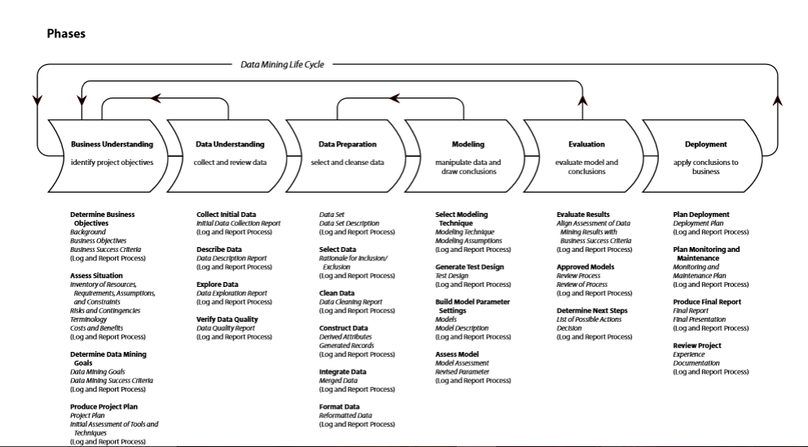
CRISP-DM Project Methodology with Deliverables

Slide 8
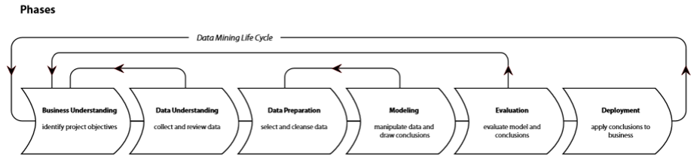
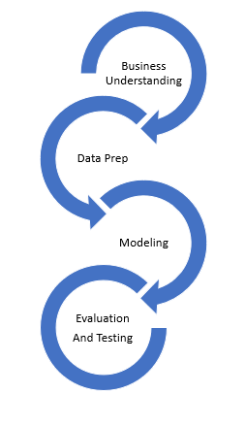
Example of An Agile Life Cycle Implementation
Prototype & Open Questions
Prototype & Open Questions
Deliverable is a report
Deliverable is a workbook
Deliverable is a web service
Action
Action
Action

Slide 9
SPIRAL CHART
Cumulative cost
Progress through steps
1.Determine
objectives
2. Validate Value Props and Identify/ Resolve Risks
Risk analysis
Commitment partition
Risk analysis
Risk analysis
Risk
analysis
Operational Prototype
Prototype 1
Prototype 2
Review
Emulations
Rqts Plan
Life cycle
plan
Concepts of require-
ments
Models
Benchmarks
Requirements
Product
design
Detailed
design
Development plan
Requirements
validation
Code
Integration and test plan
Design validation
And verification
Unit test
4. Plan the next iteration
Integration
3. Development and Test
Test
Implementation

